Slide 1
Visual Object Recognition
Tobias Ritschel

Slide 2
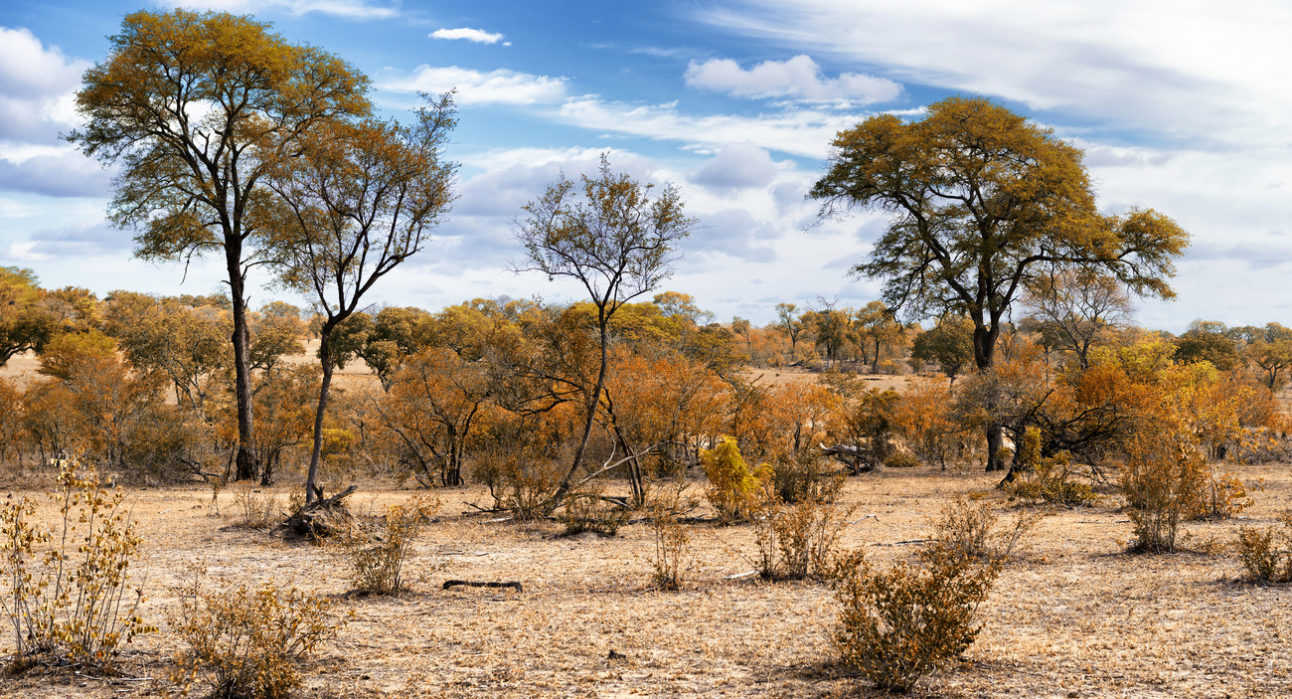

Slide 3
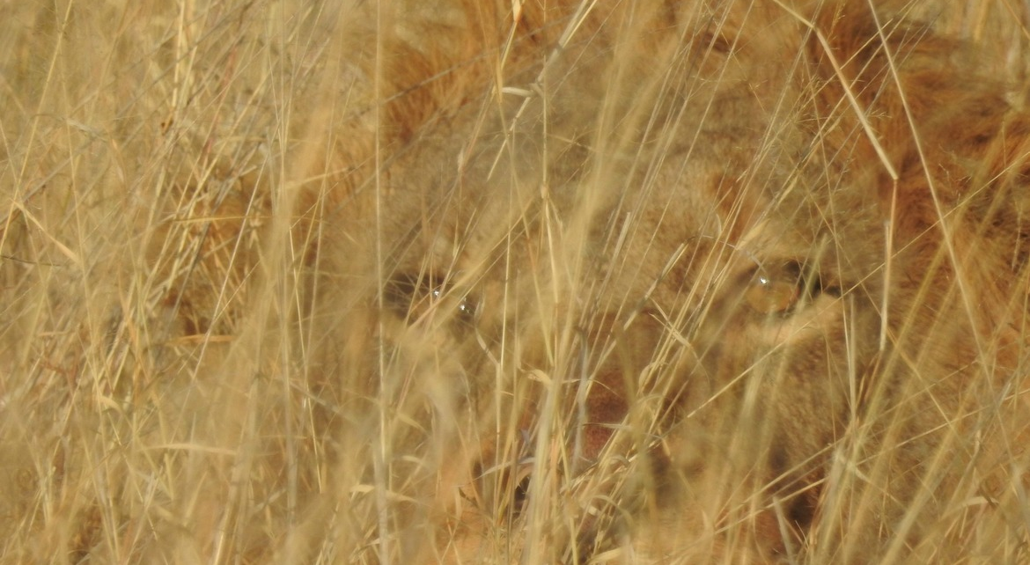


Slide 4
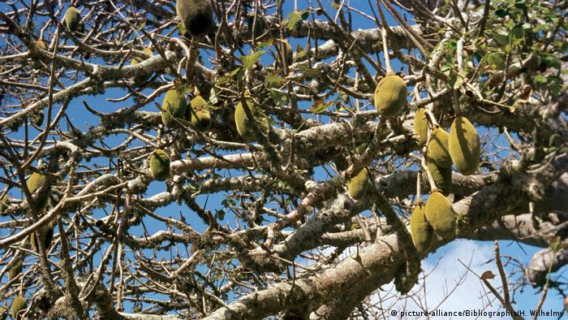


Slide 5
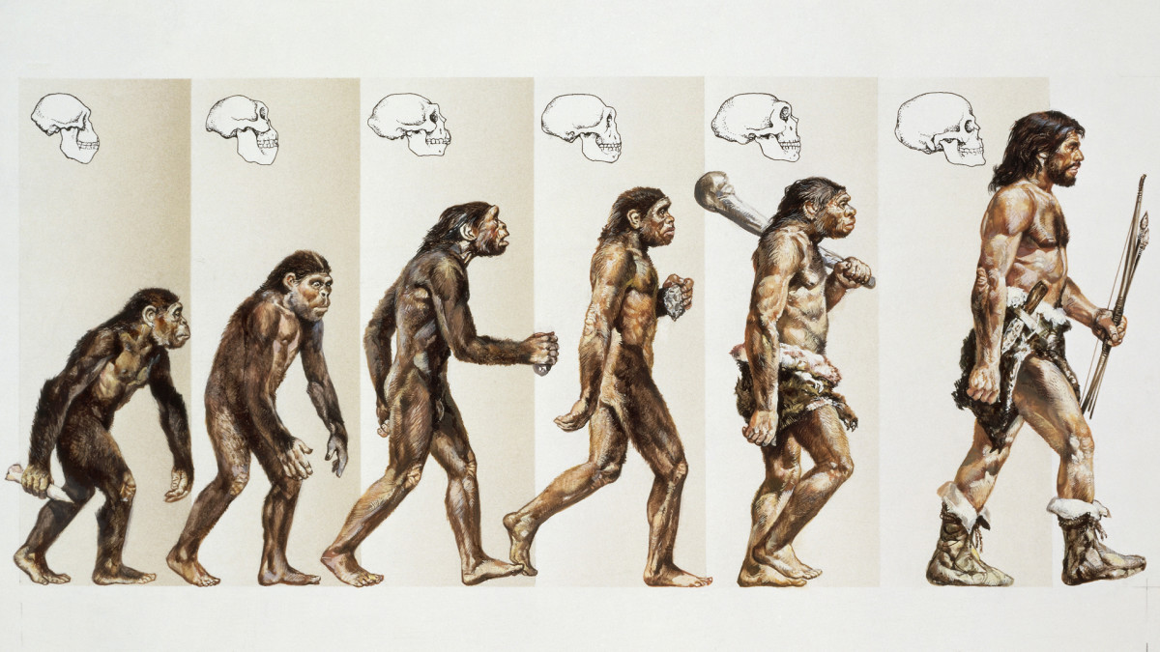

Slide 6
Overview
We will take four different views on this problem:
Low-level
Phenomenological
Neuro-physiological
Computational

Slide 7
Low-level
Hard facts about the limits of …
Spatial resolution
Temporal resolution
Chromatic perception
Luminance adaptation
Peripheral vision

Slide 8
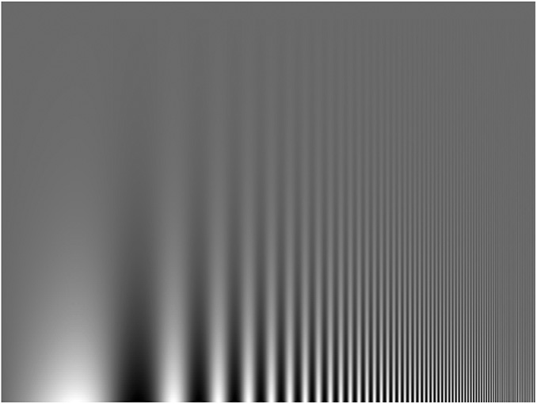
Spatial resolution
Limited by
Optics
Photoreceptor density
Campbell-Robson chart
Contrast
Frequency

Slide 9
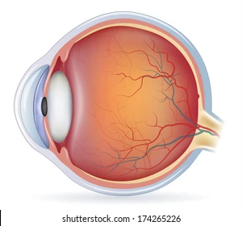
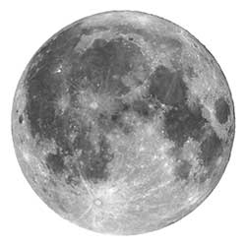
Visual angle
Don’t ask about size, distance or pixels or stuff, ask about visual angle in degree
Changes-of-something are in cycles per degree
0.5 deg
3,500 km
380,000 km

Slide 10
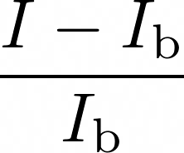


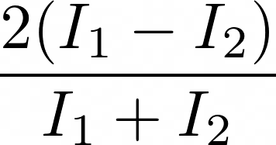
Luminance contrast
How much something is different from something else
Weber contrast
Example: (110-100)/100 = 0.1
Mitchelson contrast

Slide 11
Weber’s law
The fraction by which a stimulus needs increment to be perceived is constant
Low stimulus
High stimulus
x1.01, not perceived
x1.1, perceived
x1.01, not perceived
x1.1, perceived

Slide 12
Relation to log
To get a constant increase in response
We need an increasing change of stimulus
Like interest rates in finance or R number in CoViD
Physical stimulus
Derivative
Perception

Slide 13
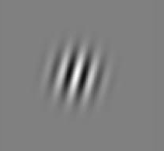
Contrast Sensitivity Function (CSF)
For Gabor patches
Spatial frequency: How often it changes per visual angle Sensitivity is to 1/contrast-threshold
Contrast-threshold: How much to add so that 70% can see
Stimulus:
100
Log sensitivity
10
1
0.1
1
10
Spatial frequency

Slide 14
Suprathreshold vs detection
Adding something to nothing (Detection)
There is never “nothing” in reality, so “very small”
Adding something-to-something (Supra-threshold)
Detection
Supra-threshold

Slide 15
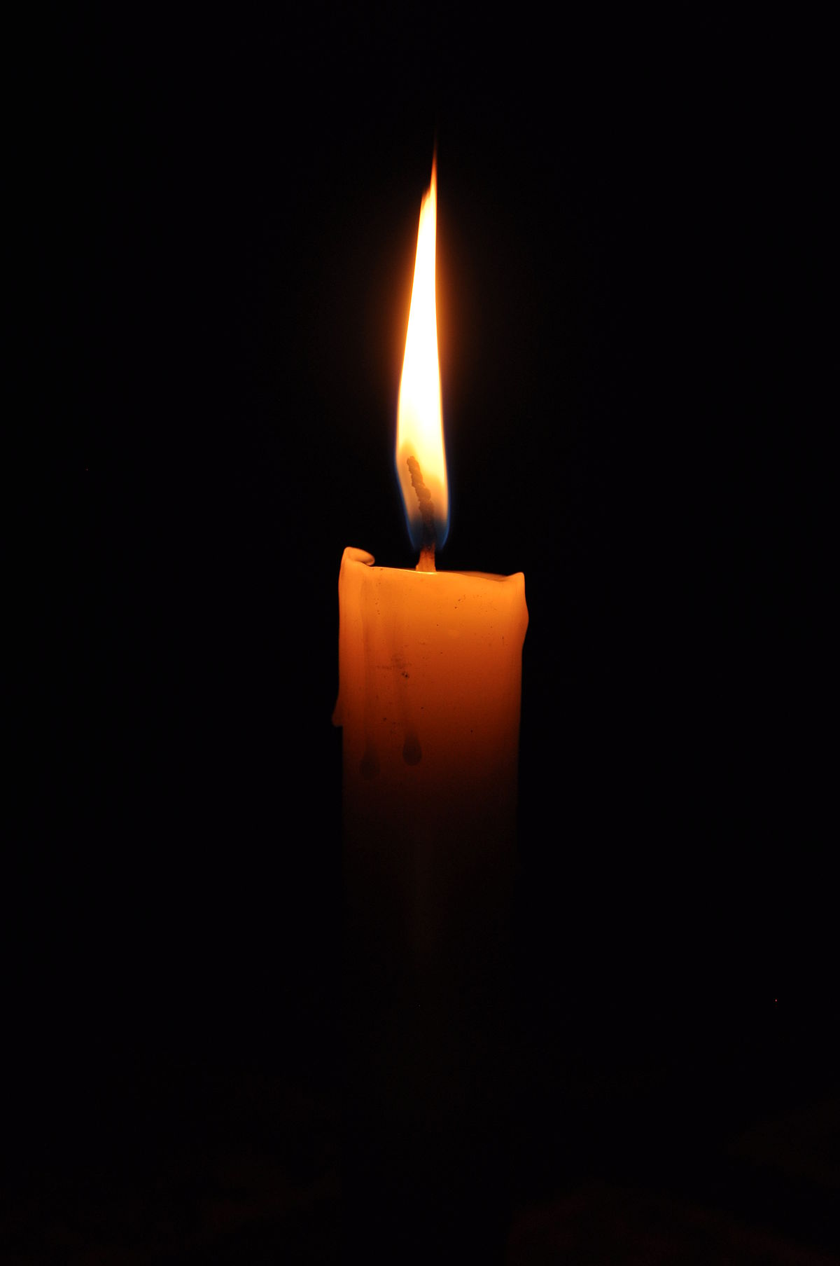

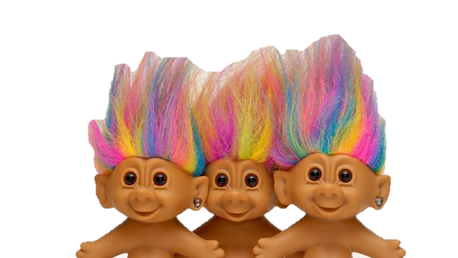
Retinal illuminance
Invariant unit is trolands that is retinal illuminance
+
~
has equivalent
troland
+
Weak
light
Large
pupil
Strong
light
Small
pupil

Slide 16
Suprathreshold CSF
There is one CSF for every base retinal luminance
Roughly:
When to dark, low freq is better
The brighter, the more there is a preferred freq around 3
100
10
Log sensitivity
1
0.1
0.1
1
10
100
Spatial frequency

Slide 17
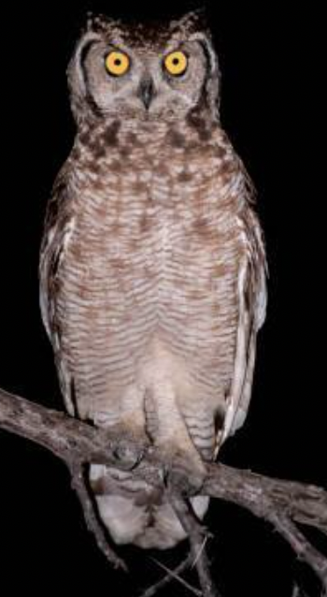
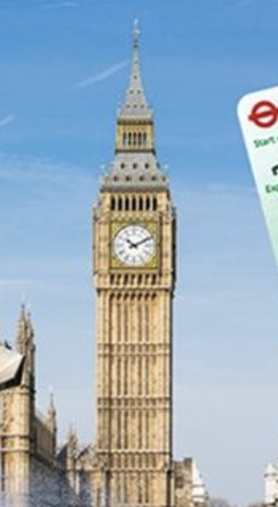

Flicker fusion
Brightness changes quicker than threshold not discerned
Depends heavily on retinal illuminance and size
60
19
3
0.3
Critical
frequency [Hz]
0
-4
-2
0
2
4
6
Log retinal luminance [Trolands]

Slide 18
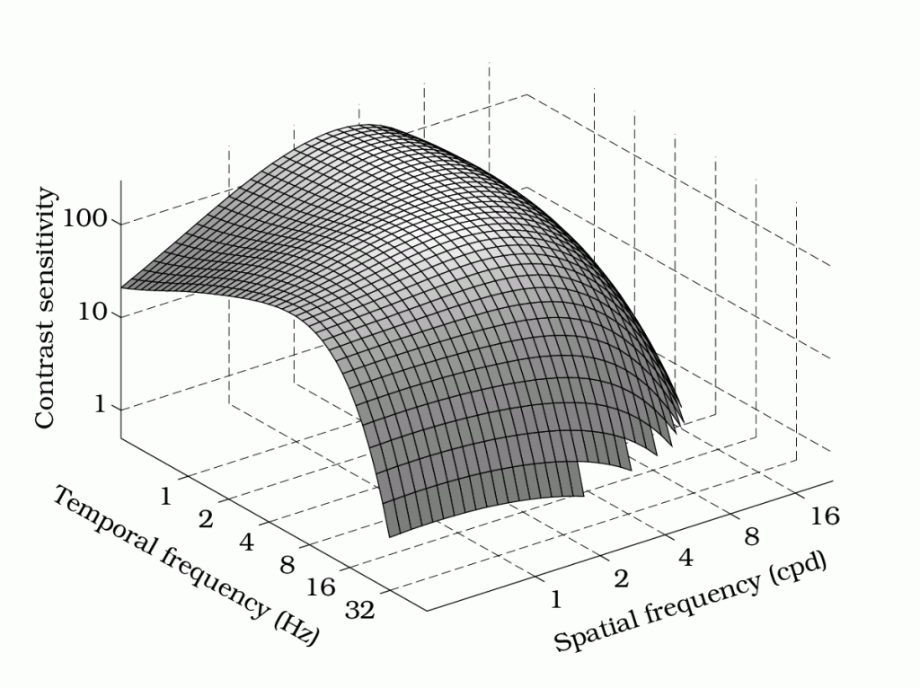
Spatio-temporal
Sinusoisal
Changing at temporal freq
Changing at spatial freq
Luminance detection threshold
At 900 Troland
Stimulus

Slide 19
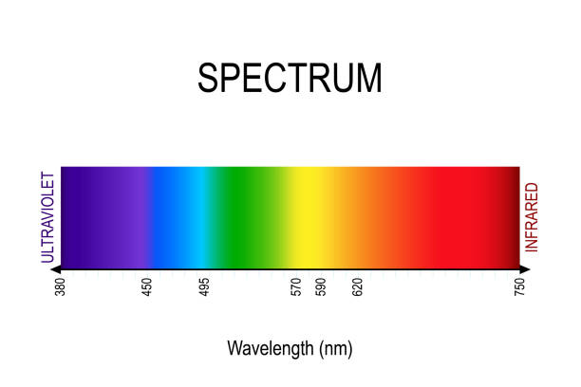
Luminance sensitivity
Luminance sensitivity depends on wavelength
Sensitivity
380 nm
Wavelength
750nm

Slide 20
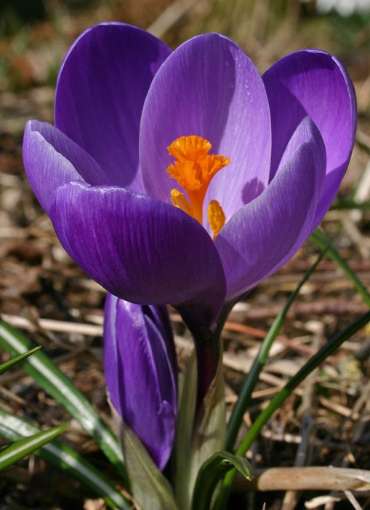
Chromatic perception
Humans perceive color
“Color“ is our name for a sensation
The physical quality is the spectrum of electromagnetic radiation

Slide 21
Trichromatism
Color sensitivity is three bases in function space
No, this isn't RGB
Short
Medium
Long

Slide 22
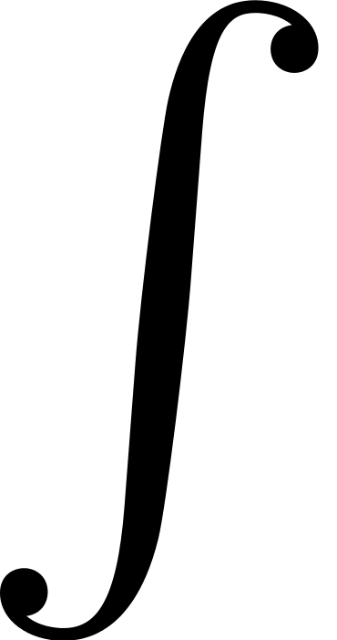
Trichromatism
Sensation is dot product of a spectrum and the basis
x
x
x
= 0.4
= 0.2
= 0.3

Slide 23
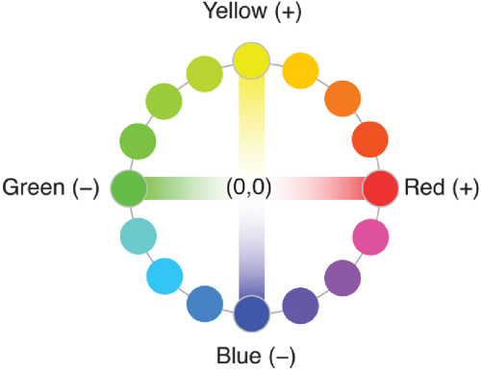
Color opponency and luminance
These three responses are mapped into
A one-dimensional sensation of luminance
A two-dimensional sensation of chrominance
We see physiology of this later

Slide 24
Chromatic sensitivity function
How much do you need to add to a spatial colored pattern to see the change
300
Luminance
Red-green
30
Sensitivity
3
0.3
Blue-yellow
0.03
0.1
0.3
1
3
10
30
100
Spatial frequency

Slide 25
Luminance Adaptation
HVS adapts to the average physical luminance
Allows us to see in day and night, ten orders of magnitude
Several details change across that range, we later see how
At one point in time, only two orders of magnitude
Example bracket
Scotopic
Photopic

Slide 26
Luminance Adaptation
Threshold depend on absolute field intensity
3
Saturation
2
1
0
Log sensitivity
-1
Weberian
-2
-3
Dark
-4
-8
-4
0
4
8
Log field intensity

Slide 27
Spatial contrast at night
We see fewer spatial details at night
Subtle value changes missing
High freq missing
Photopic
Scotopic

Slide 28
Time course of adaptation
Adaptation takes considerable time to be effective
Threshold
0
25 minutes

Slide 29
Color perception in the dark
The luminance efficiency function shifts its peak
Purkinje shift
3
Photopic
2
1
0
Log sensitivity
Scotopic
-1
-2
-3
-4
350 nm
750 nm
Wavelength

Slide 30
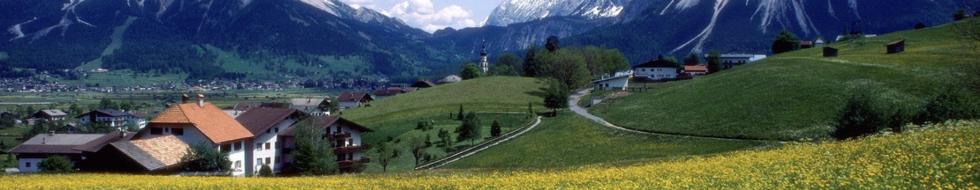
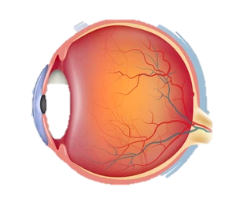
Peripheral vision
We perceive more details in the center of our visual field (more later as to why)
I do not draw this as blur as it is not blur
Fovea
More details
Periphery
Less details

Slide 31
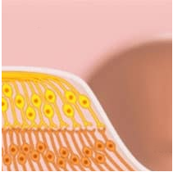
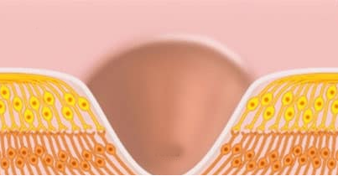
Foveation (Virso and Rovamo 1979)
We perceive more details in the center of our visual field (more later as to why)
Fovea perceives
More higher frequencies
More details in value
100
10
Log sensitivity
Periphery
Periphery
1
0.1
1
10
100
Spatial frequency
Fovea

Slide 32
Literature
Wandell, Brian A. ”Foundations of vision.” Sinauer Associates, 1995.
Campbell, Fergus W., and John G. Robson. "Application of Fourier analysis to the visibility of gratings." The Journal of physiology 197.3 (1968): 551.
Van Nes, Floris L., and Maarten A. Bouman. "Spatial modulation transfer in the human eye." JOSA 57.3 (1967): 401-406.
Virsu, V., and J. Rovamo. "Visual resolution, contrast sensitivity, and the cortical magnification factor." Experimental brain research 37.3 (1979): 475-494.

Slide 33
Phenomenological
What kinds of phenomena in visual perception exist?
Less a solution to anything, more a shopping list of what to account for
Illusions
Depth cues
Monocular
Binocular
Fusion
Gist

Slide 34

Mach bands
Piecewise constant
Perceived as curved
Physical
Perceived

Slide 35

Cornsweet illusion
Two constant colors with wedge at the junction
Perceived as different brightness
Physical
Perceived

Slide 36
Depth cues
We want to understand how far away the lion is
Monocular
Pictorial
Relative size
Occlusion
Aerial perspective
Non-pictorial
Lens accommodation
Binocular
Vergence
Binocular disparity

Slide 37
Familiar size
We know a banana is smaller than a lion
Hard to imagine this is a huge banana in the sky and a tiny lion, no?

Slide 38
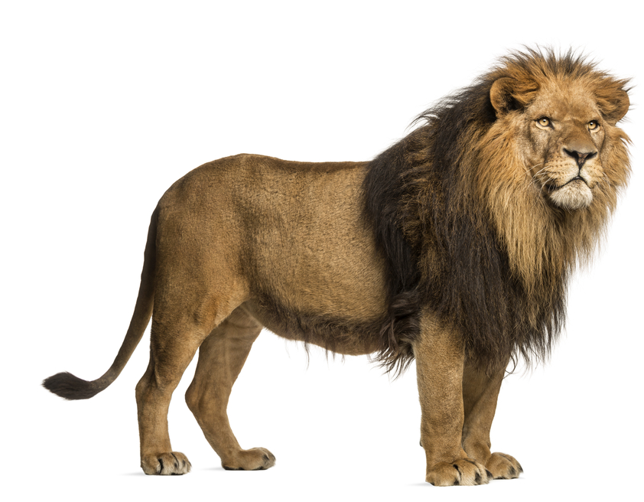
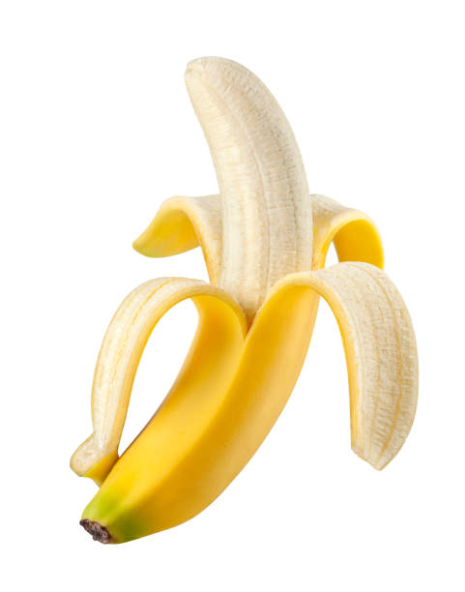
Familiar size
Works better with natural images

Slide 39
Relative size
Larger objects of same familiar size perceived closer

Slide 40
Linear perspective
Linear perspective enforces.
Objects on perspective lines are same-size

Slide 41
Size over horizon
Adding a horizon, the pictorial relation is enforced further

Slide 42
Occlusion
Closer objects occlude more far-away objects
Works extremely well across all distances
Only ordinal

Slide 43
Density
Density is associated with distance
A bit weaker

Slide 44
Moon illusion
Why does the moon look so large on the horizon?
It gets silly … Godzilla banana

Slide 45

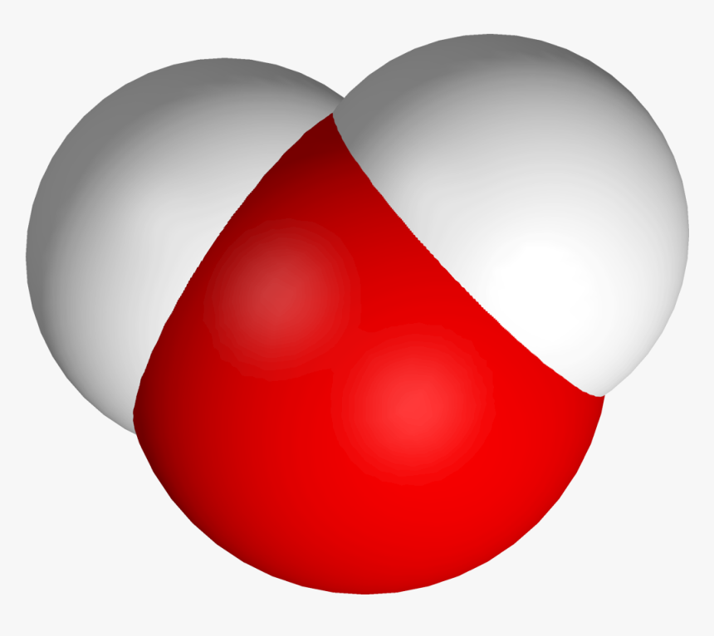
Aerial perspective
Light is scattered in the atmosphere
Scatter different at different wavelength
Longer light path, more scattering
More blue, more path, more distance
Spectrum
Water
Scattering

Slide 46

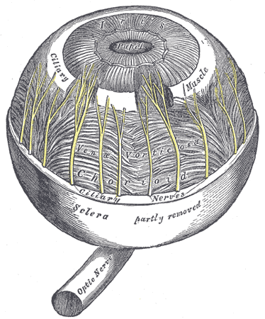
Lens Accommodation
Monocular but not pictorial
Objects at a certain distance will be sharp
Objects at other distances will be blurry
Out of focus
In focus

Slide 47
Accommodation: How it works
Rays from a point at some depth map to a distance-dependent area
Near
Depth
Far
Retina

Slide 48

Accommodation: How it works
Rays from a point at some depth map to a distance-dependent area
Area is blur
From lens state and blur, we can compute depth
Near
Depth
Far
Retina

Slide 49
Accommodation: How it works
Lens is flexible
At different state, different things are in focus
Near
Depth
Far

Slide 50
Binocular Convergence
Eyes form different angles fixating
Muscles measure that angle
Near
Depth
Far

Slide 51
Binocular Convergence
Eyes form different angles fixating
Muscles measure that angle
Near
Depth
Far

Slide 52
Binocular disparity
Signed difference between retinal locations of same world points depends on depth
Left
eye
Right
eye
Near
Depth
Far

Slide 53
Binocular disparity
Requires to match points
Same distance, same depth
Depends on vergence
Left eye
Right eye

Slide 54
Binocular disparity
Left eye
Another way to see it
Horopter is surface of points you verge on
Objects at horopter
Do not change position between eyes
Lion here
Objects away from it
Do change
Bana here
Right eye

Slide 55
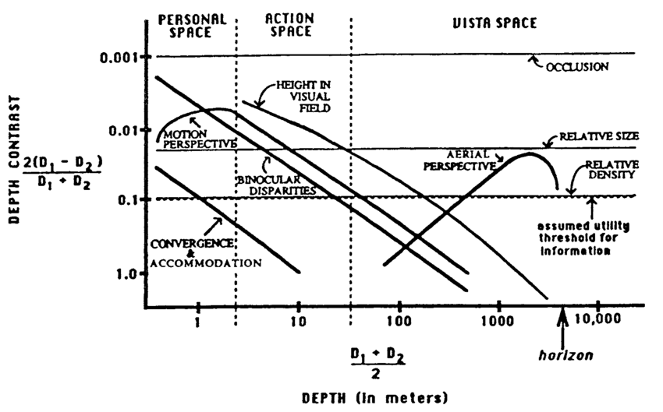
(Cutting and Vishton, 1995)
Different depth cues are differently effective at different absolute scales

Slide 56
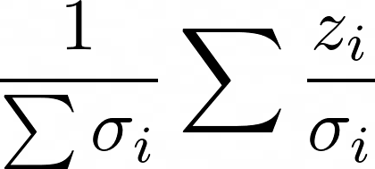
Fusion (Landy 1995)
The cues are fused
HVS has a notion of confidence
Cues are fused Bayesian
Depth of cue i
Sum over cues
Confidence of cue i

Slide 57
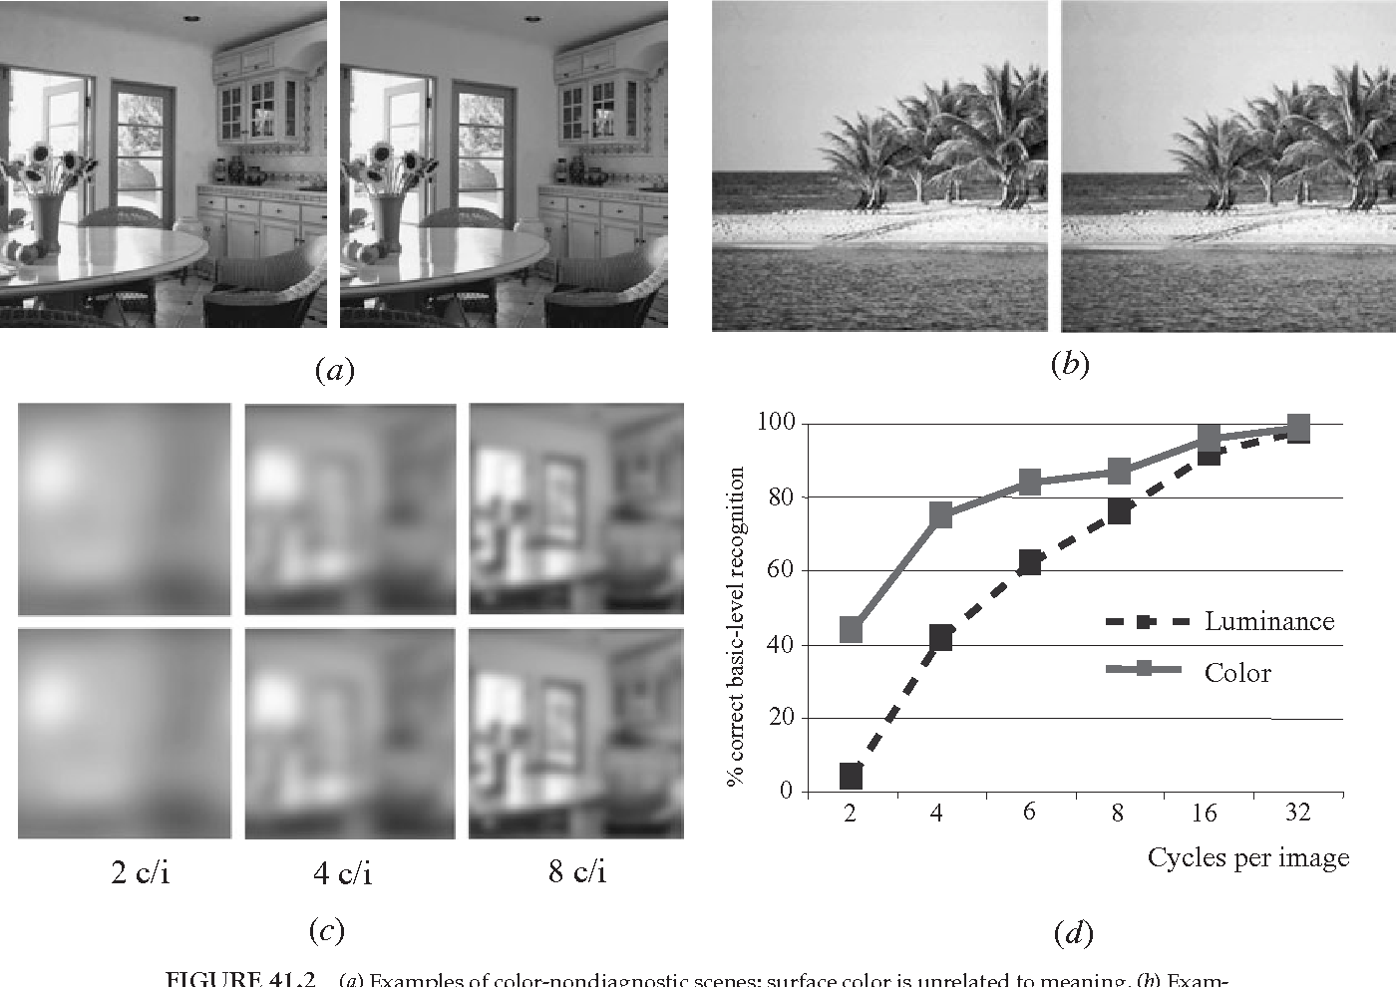
Gist (Olivia 1995)
Show an image of a category extremely quickly
Humans can say what it is, like landscape vs city
Mostly texture perception

Slide 58
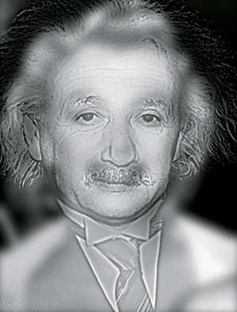
Hybrid images (Olivia 1995)
Image that look like scene A from far
And like image B from a near
Produced by choosing optimal frequencies for that distance

Slide 59
Literature
Landy, Michael S., et al. "Measurement and modeling of depth cue combination: in defense of weak fusion." Vision research 35.3 (1995): 389-412.
Cutting, James E., and Peter M. Vishton. "Perceiving layout and knowing distances: The integration, relative potency, and contextual use of different information about depth." Perception of space and motion. Academic Press, 1995. 69-117.
Oliva, Aude. "Gist of the scene." Neurobiology of attention. Academic press, 2005. 251-256.

Slide 60
Neuro-physiological
What is going on neurologically when we recognize?
Pupil
Retina
Receptive fields
LGN/Optical Chiasm
Visual Cortex
Bigger picture: Invariance

Slide 61
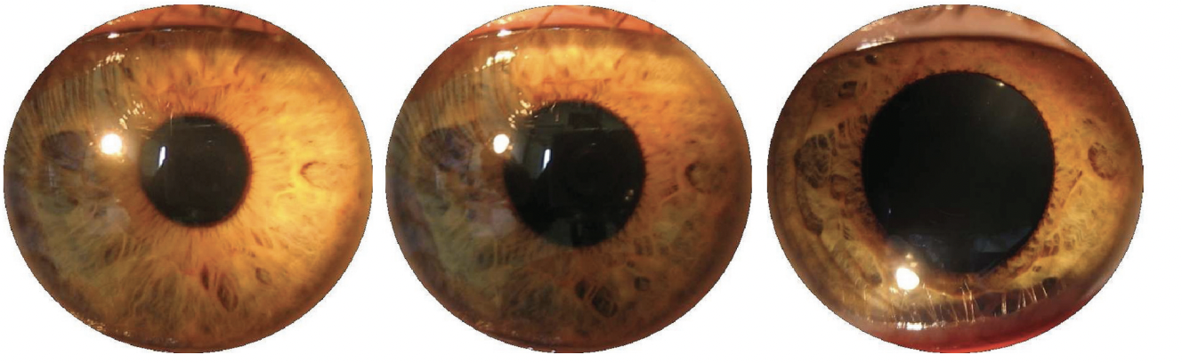
Pupil
Controls how much light falls onto the retina
Part of the adaptation
Large pupil
High field intensity
Medium pupil
Normal field intensity
Large pupil
Low field intensity

Slide 62
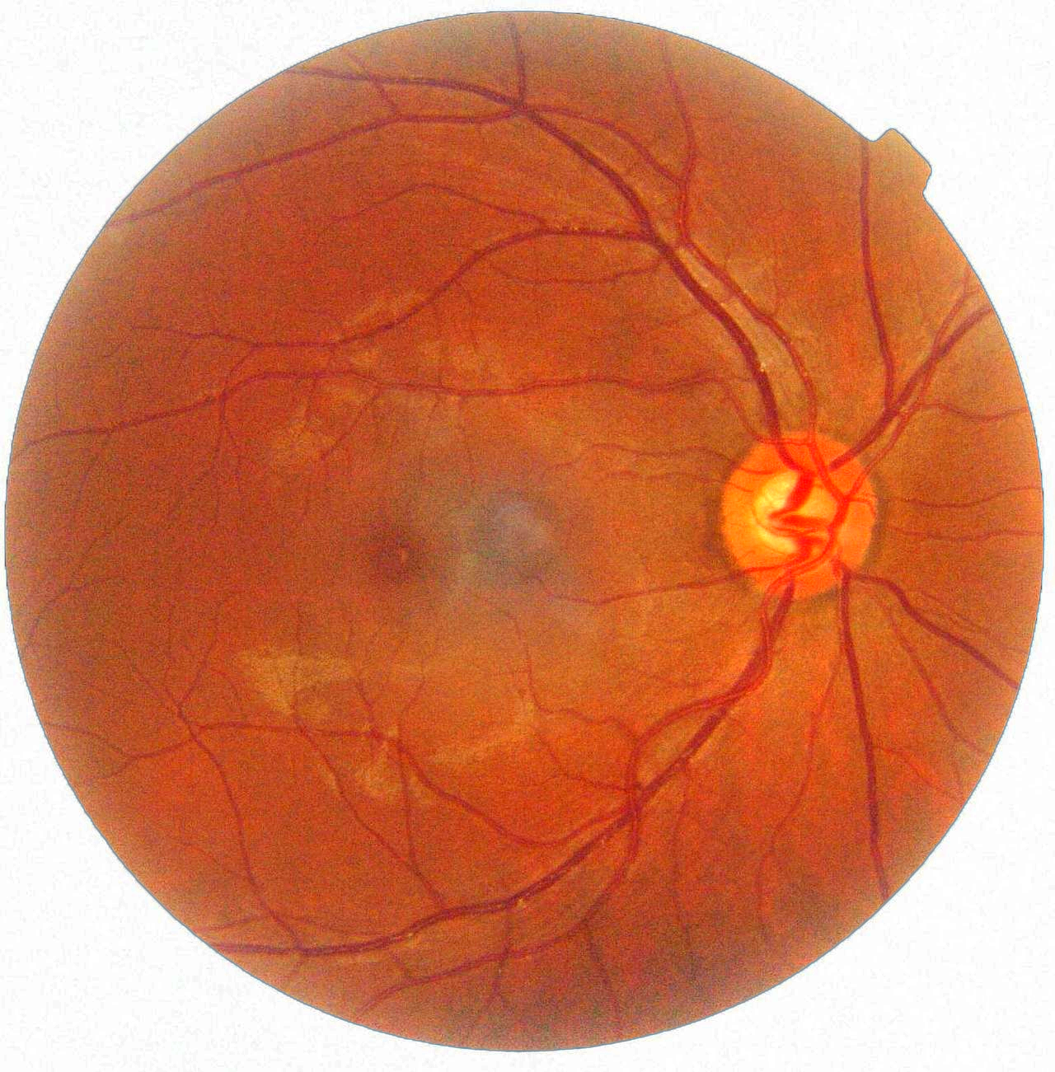
Retina
Converts light into nerve impulses
Covered by photoreceptors
Denser in the fovea
None in the blind spot
Blind spot
Fovea

Slide 63
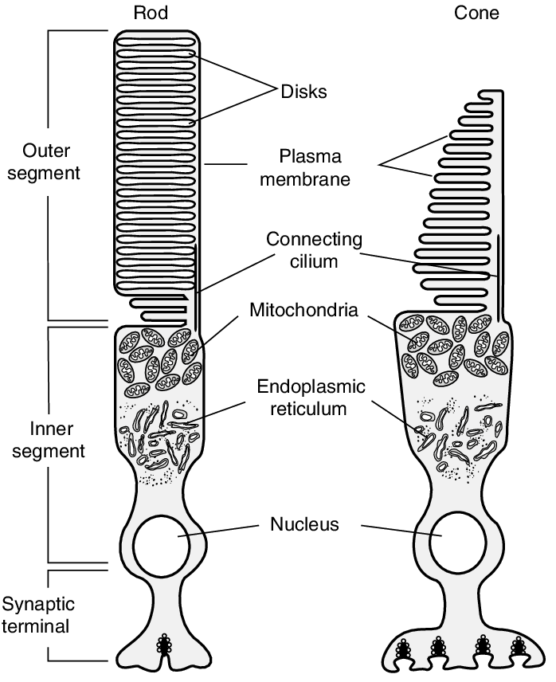
Photoreceptors
Two kinds of photoreceptors
Rods
Luminance
Day and night
Cones
Color (so three kinds-of)
Day-only
Ganglion cells
Not for image formation, circadian
Adaptation in part done by flipping between these

Slide 64
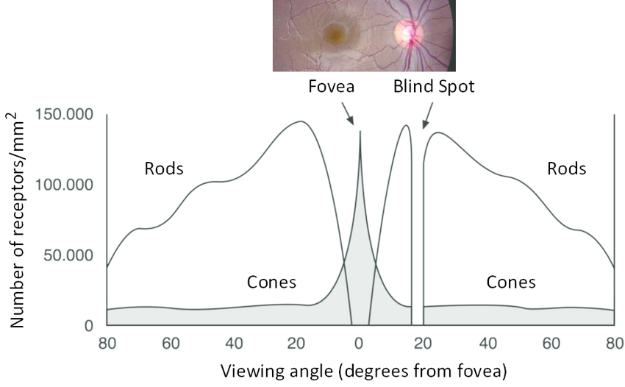
Foveation
Physiological reason for foveal vision is receptor density
150,000
Per mm^2
Density
80 deg
View angle
80 deg

Slide 65
Receptive field
Photoreceptors are combined on-site in the retina
On-center
Fires
Does not fire
Does not fire
Does not fire
Off-center
Does not fire
Fires
Does not fire
Does not fire

Slide 66
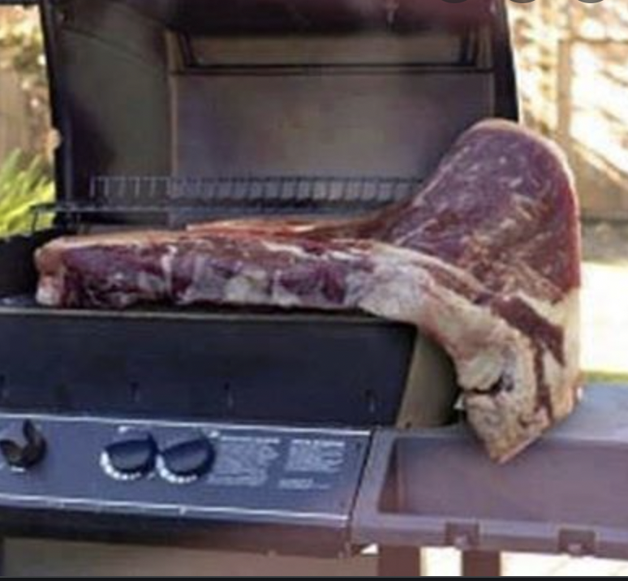
No Sparsification: Eat much

Slide 67
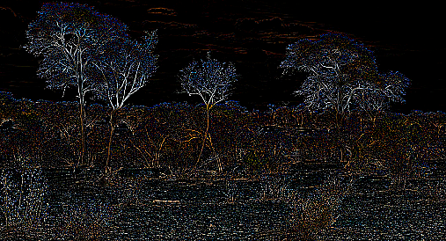
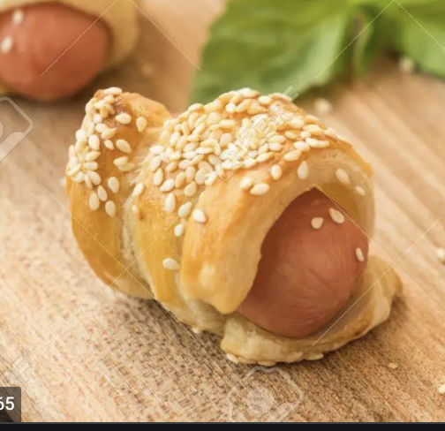
Sparsification: Eat little

Slide 68
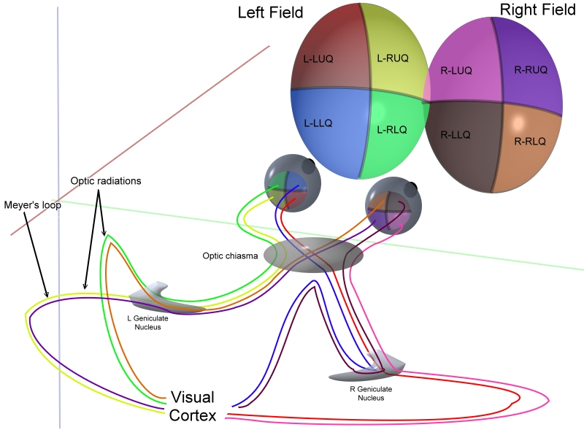
LGN/Optical Chiasm

Slide 69
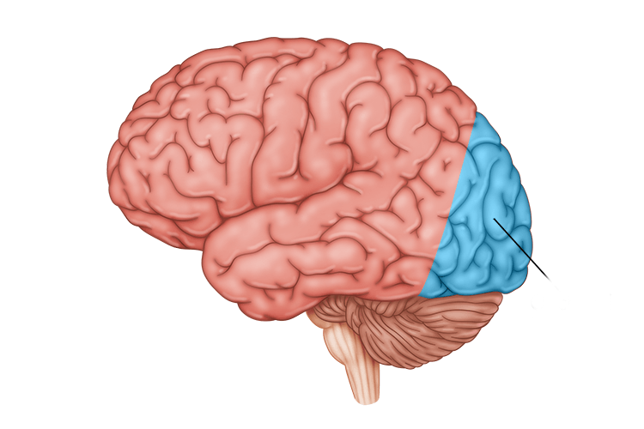

Visual cortex
Images literally get projected onto a part of the brain

Slide 70
Cortical receptive fields
Cortex selects frequencies and orientations of patterns
Three levels
Simple
Complex
Hypercomplex

Slide 71
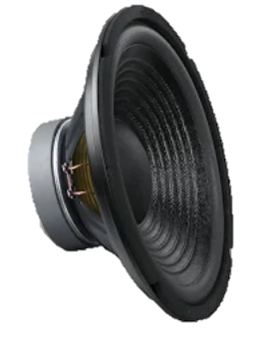
Experiment (Hubel & Wiesel, 1959)
Important experiment
Anesthesized cat
Looks at a screen
Electrode capture cortical activity
Connected to loudspeaker

Slide 72


Slide 73
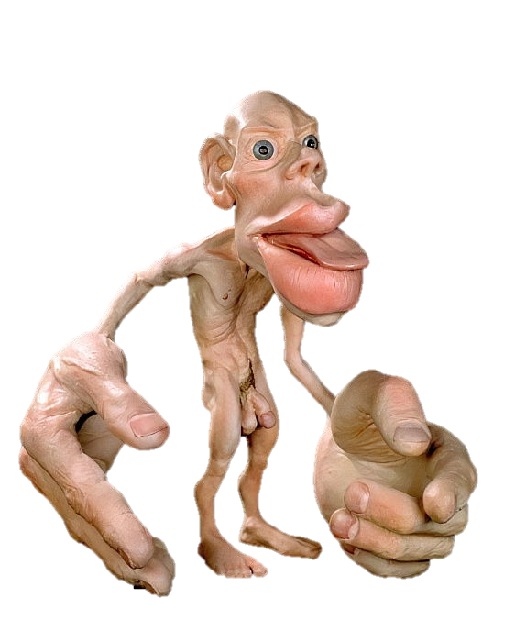
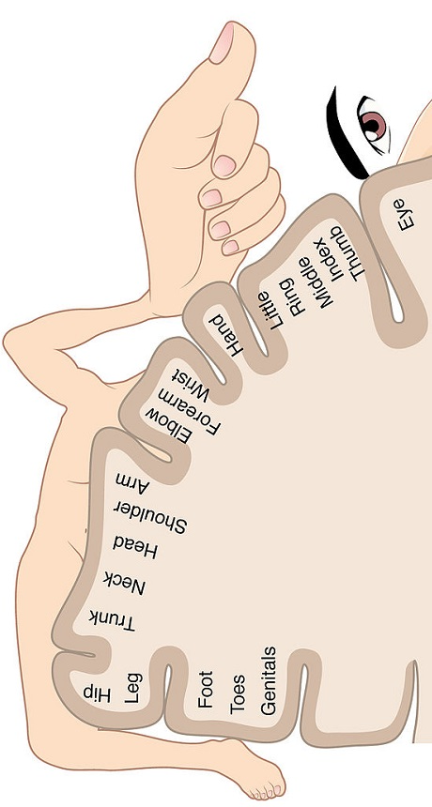
Cortical map (Virsu and Romavo 1979)
(Foveal) areas with higher receptor density are represented larger in the cortex
Retinal
Light field
Cortical
representation

Slide 74
Literature
Hubel, David H., and Torsten N. Wiesel. "Receptive fields, binocular interaction and functional architecture in the cat's visual cortex." The Journal of physiology 160.1 (1962): 106.

Slide 75
Computational
How can I model these steps using a computer
Neural network
Cognitron
Neocognitron (Pooling)
Convolutional neural network

Slide 76
Simplification
Consider a simplification:
16 photoreceptors in 1D
Monocular
Monochromatic

Slide 77
Simplification
Simplification:
16 photoreceptors in 1D
Monocular
Monochromatic

Slide 78



Neural network
Input is vector
Output is vector
Vector-to-vector is matrix
Probability of being a ….

Slide 79
Evoluion / learning

Slide 80
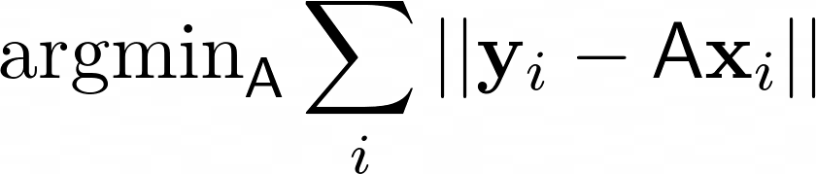
Evolution / learning
Evolution or learning optimizes the relation of input and output over all items
The target is unknown, but if a solution does not meet it, it will reproduce less
Notes:
\operatorname{argmin}_\mathsf A \sum_i||\mathbf y_i-\mathsf A\mathbf x_i||

Slide 81
Backprop (Rummelhart et al. 1986)
If you have any function with parameters
And you know for every input what the output should be
For all inputs
Pass input through the function
Compute difference between desired and current result (loss)
Change the parameters so that the loss is reduced
This is not biologically plausible
This is evolutionary plausible

Slide 82
Grandmother / lion cell

Slide 83
Grandmother / lion cell: Translation

Slide 84
Grandmother / lion cell: Brightness

Slide 85
Grandmother / lion cell: Scale

Slide 86
Invariance
Problem: Response not invariant under transformations
Translation
Scale
Rotation
Perspective
Brightness
Etc
Solution
HVS is a fat complex mapping to produce this invariance

Slide 87
Simple example: brightness
All these three predators should have the same response
Radiance
Radiance
Radiance
Space
Space
Space

Slide 88

Solution 1: Edge filters (Marr and Hildreth, 1980)
Edge filtering alone already does this
Radiance
Radiance
Radiance
Space
Space
Space
Radiance
Radiance
Radiance
Space
Space
Space

Slide 89
Solution 2: Adaptation
Simply changing the pupil achieves this
Radiance
Radiance
Radiance
Space
Space
Space
Radiance
Radiance
Radiance
Space
Space
Space

Slide 90
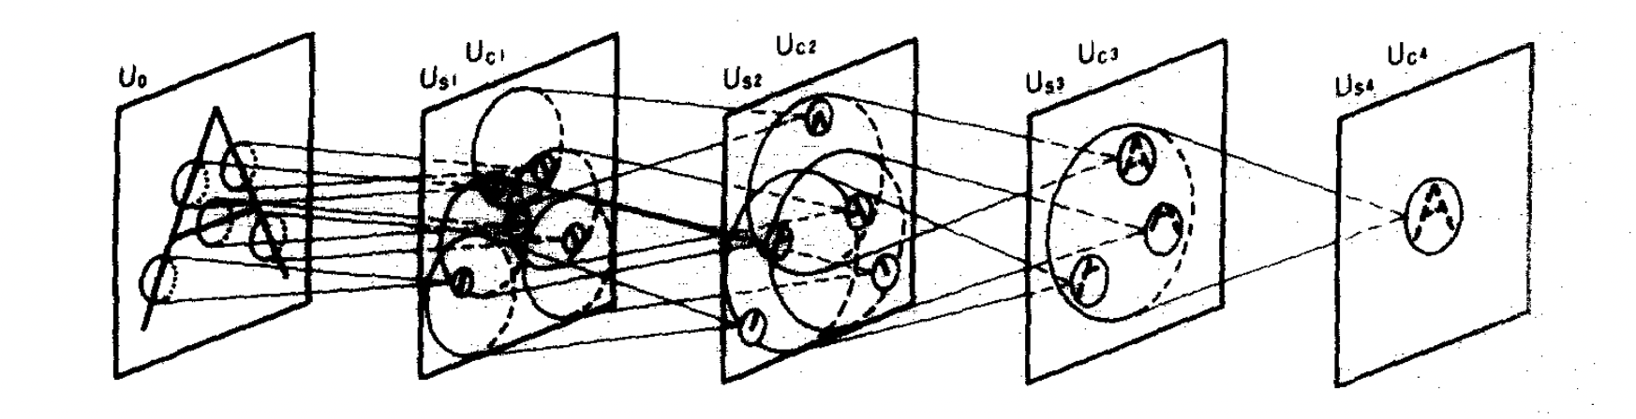
Neocognitron (Fukushima, 1982)
Idea: Pooling
In a spatial area, count how often a feature is present
A-example:
Check if things are present in a combination
Don’t care so much, where exactly

Slide 91
Convolutional neural networks (CNNs)
Training it with convolutions (LeCun et al. 1989)
Stacking many such things (Krizhevsky et al. 2012)
Use multiple resolutions (Ronneberger et al. 2015)

Slide 92
Literature
Rumelhart, David E., Geoffrey E. Hinton, and Ronald J. Williams. "Learning representations by back-propagating errors." Nature 323.6088 (1986): 533-536.
Fukushima, Kunihiko, and Sei Miyake. "Neocognitron: A self-organizing neural network model for a mechanism of visual pattern recognition." Competition and cooperation in neural nets. Springer, Berlin, Heidelberg, 1982. 267-285.
Marr, David, and Ellen Hildreth. "Theory of edge detection." Proceedings of the Royal Society of London. Series B. Biological Sciences 207.1167 (1980): 187-217.
LeCun, Yann, et al. "Handwritten digit recognition with a back-propagation network." Advances in neural information processing systems (1989).
Ronneberger, Olaf, Philipp Fischer, and Thomas Brox. "U-net: Convolutional networks for biomedical image segmentation." International Conference on Medical image computing and computer-assisted intervention. Springer, Cham, 2015.

